Slide 1


SOFTWARE ENGINEERING DIET AND WORKOUT ASSISTANT

Slide 2
Team Members
2110030009 : g. Vaishnavi
2110030014 : g. Haritha Maithreyee
21100300065 : A. Bhavya Sri
2110030147 : G. Mahitha christina
Under the guidance of
Dr . Sheik fahad ahmad

Slide 3
Problem statement and domain
People complain that the coaching is inconsistent and that the responses feel canned.
People also complain that the database lacks many foods, is unreliable ,and that tracking food on plan is a big plan.

Slide 4
Flaws of previous researches
The existing Dietitian System of getting a diet plan is completely manual.
People need to visit their local Dietitian physically to know the suggested diet plan.
The user has to wait for their appointment with the Dietitian.
The user might have to wait for long hours some times.
This makes it very inconvenient for the users to get their diet plan.
They have to wait just to get the information about what they should eat.

Slide 5
Literature Review
The proposed dietitian system is online having artificial intelligence of diet plans.
the user has to then enter his eating timings and the system presents him/her the diet plan that would be best for the particular user.
All the food items along with the quantity is shown to the user.
If the user doesn't like the current diet plan, the system modifies food items keeping the total nutritional value same.

Slide 6
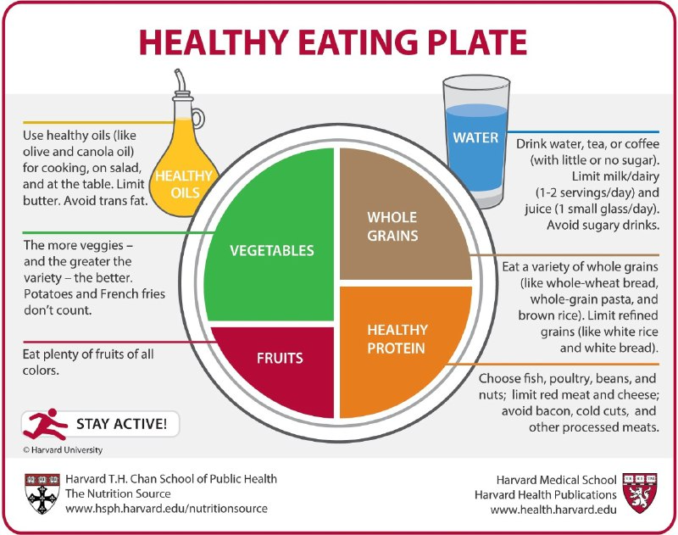
article

Slide 7
Srs document

Slide 8
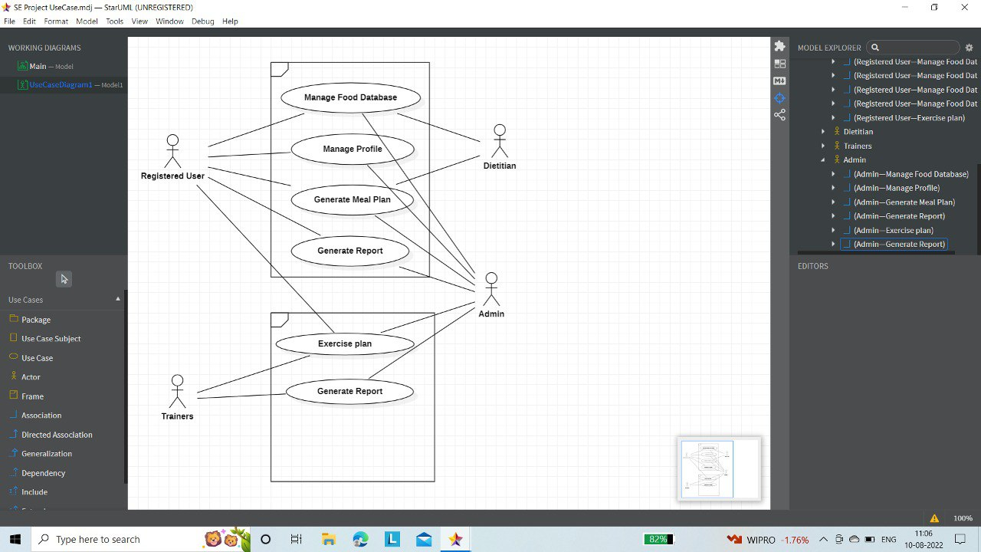
USECASE Diagram

Slide 9
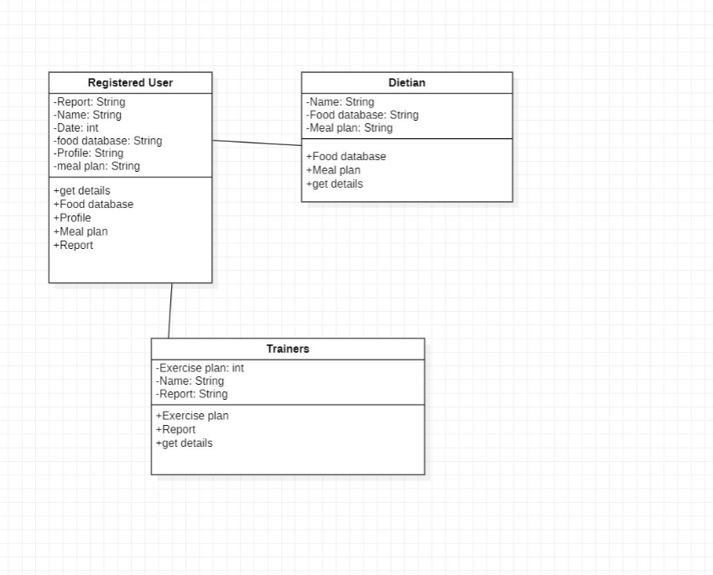
CLASS Diagram

Slide 10
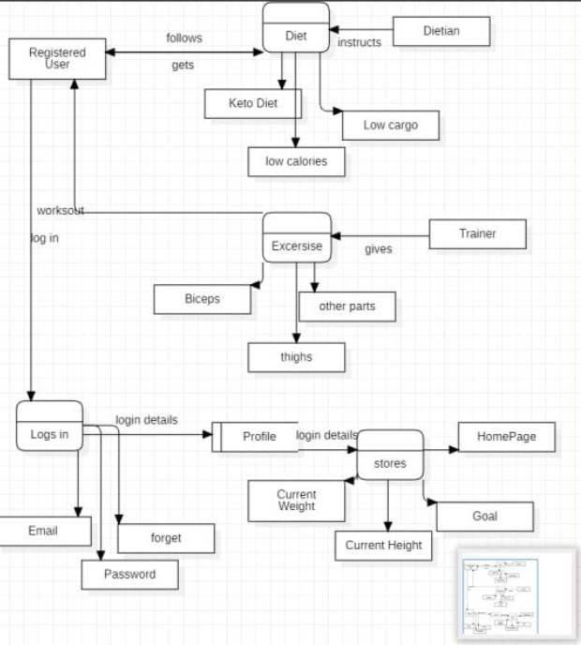
DATA FLOW Diagram

Slide 11
sources
https://www.muscleandfitness.com/nutrition/healthy-eating/28-days-meal-plan-lean-muscle/
https://www.healthline.com/health/fitness/4-week-workout-plan-for-weight-loss
https://www.muscleandfitness.com/nutrition/healthy-eating/ultimate-diet-plan-beginners/
https://apps.who.int/iris/bitstream/handle/10665/325828/EMROPUB_2019_en_23536.pdf

Slide 12
TOOls required
Django:
This is used to implement the front end code and its designing.
Star uml:
this is used for doing the uml diagrams for understanding user requirements
My SQL:
This is a back end part that is used for retrieving and updating the data.

Slide 13
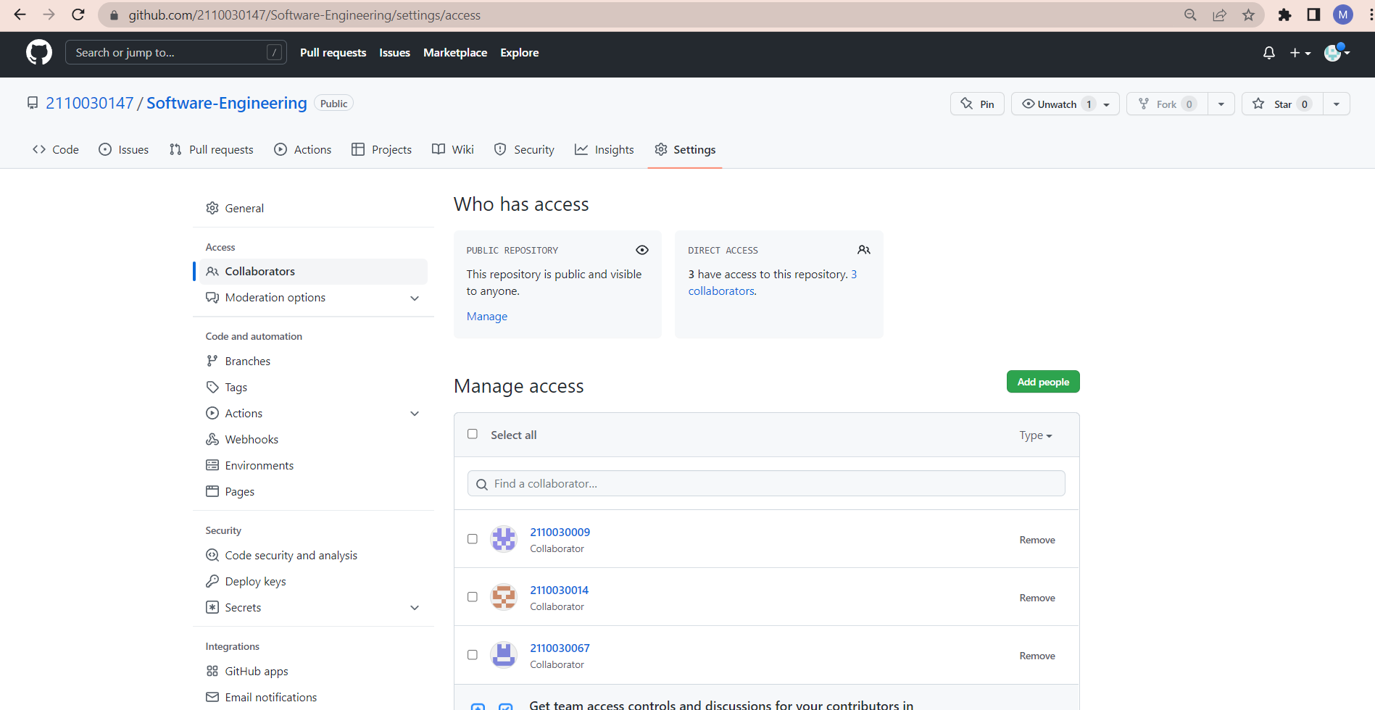
Github Setup https://github.com/2110030147/Software-Engineering/settings/access

Slide 14
Division of work among the group members
2110030014 G.Haritha Maithreyee: font end along with coding
2110030147 G.Mahitha Christina: backend working along with developing Se models
2110030009 G.Vaishnavi: font end along with coding
2110030067 A.Bhavya Sri: Data set collection and coding

